Slide 1


flashNfun

Slide 2
PRESENTED BY
SAMIBRATA GHOSH
TUHIN DUTTA
SAYAK CHATTERJEE
SHUBHADEEP CHOWDHURY
BASTAB DEY
DIPANJAN BANERJEE

Slide 3
CONTENTS
INTRODUCTION
TIC-TAC-TOE
RESCUE OUT PIKACHU
CRYSTAL BEAKOUT
SNAKE
THE MAZE GAME
JUMPING BALL
COPTER CRASH
RUSH
TETRIS
PING - PONG
GALAXY WAR
PRIMAL CRIMES
DATABASE
WEBSITE DESIGN
CONCLUSION

Slide 4
INTRODUCTION
We have developed is a flash game portal for which we have developed a few interesting games.
In order to play these games the user will have to create an account. This account will help the users to play the games of one’s choice.
The account will also enable the user to view one’s highest score in a session and also their top scores in each game till date.
To maintain the competitive edge we have included the provisions for users to see the highest scores in each game made by other users.
The games have been designed to run on web browsers and have been designed using JavaScript, HTML , Bootstrap and CSS.
For the backend of the project i.e. to maintain the database we have used PHP and MySQL.

Slide 5
GAME 1

Slide 6
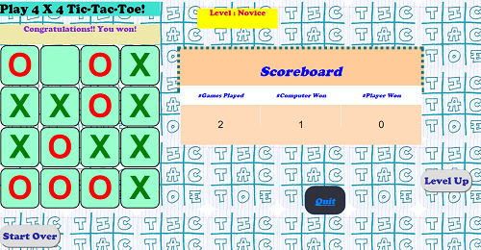
4x4 Tic-Tac-Toe
Game Development Modules:
Minimax & Alpha-Beta pruning
Can_I_Fork & Has_User_Forked
Game UI( scoreboard, playing-board)
Game Control( start, quit, level-setter, message-bar, score)

Slide 7
GAME 2

Slide 8
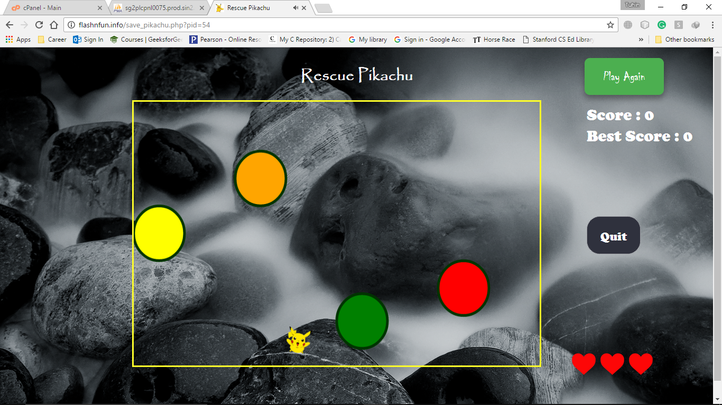
Rescue Pikachu
Game Development modules:
Game UI & Animation( Rock, Pikachu)
Game control( Quit, play-again, Life, score)
Pika movement & collision detection

Slide 9
GAME 3

Slide 10
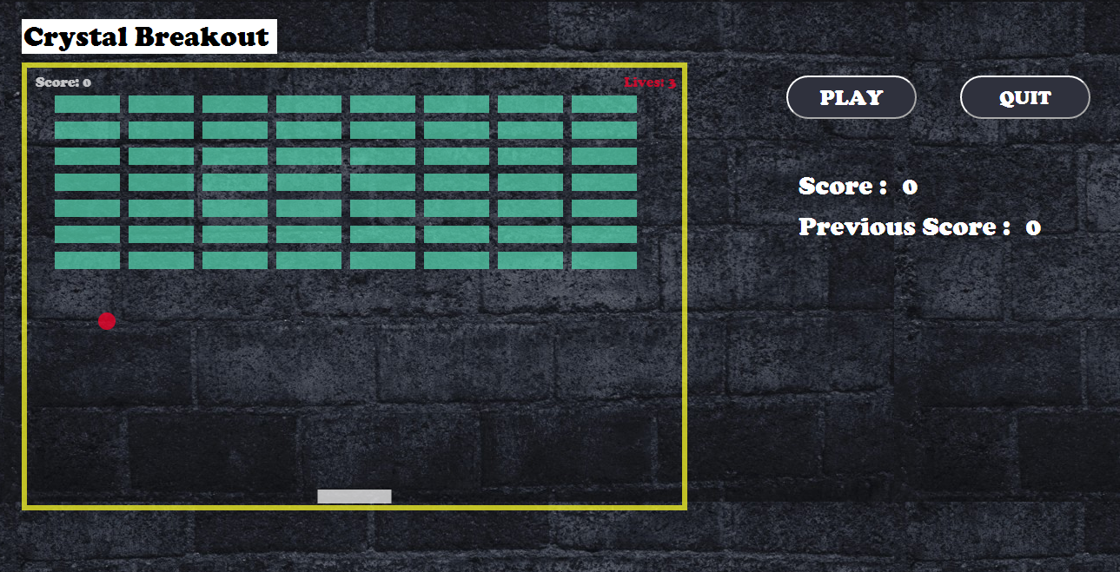
Crystal Breakout
Game Development Modules:
Arcade Flash Game.
Game UI (canvas with a layer of crystals, a paddle and a ball to hit those crystals)
Game Control (play, quit, score, highest score)
Ball and Paddle Movement and collision detection

Slide 11
GAME 4

Slide 12
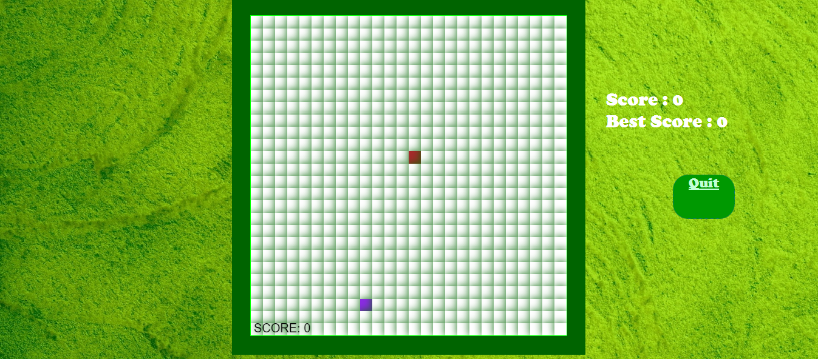
Snake Classics
Game Development Modules:
Works in FIFO concept.
Catches food, increases its own size, changes color at intervals.
Grid reference.
Game Control(play, quit, score)
Game UI (canvas where snake and food is kept)
Chief functions(fillRect(), draw(), Update())
If snake touches itself or the wall “Game Over”

Slide 13
GAME 5

Slide 14
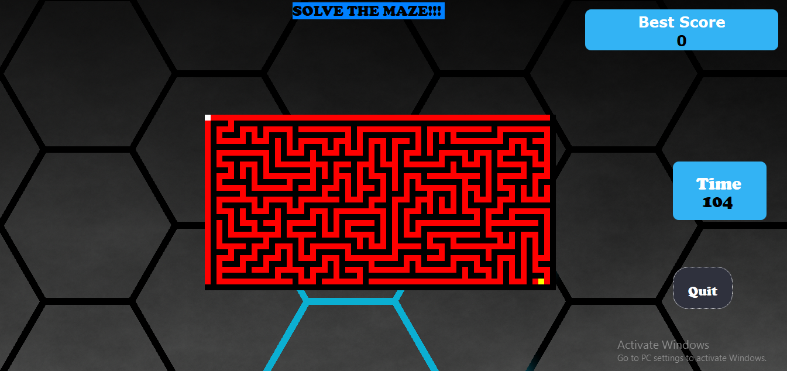
THE MAZE GAME
Game Development Modules:
Generating the maze (Recursive backtracking algorithm).
Player movement.
Collision detection.
Game UI (timer , difficulty levels , quit , play).
Score and best score display.

Slide 15
GAME 6

Slide 16
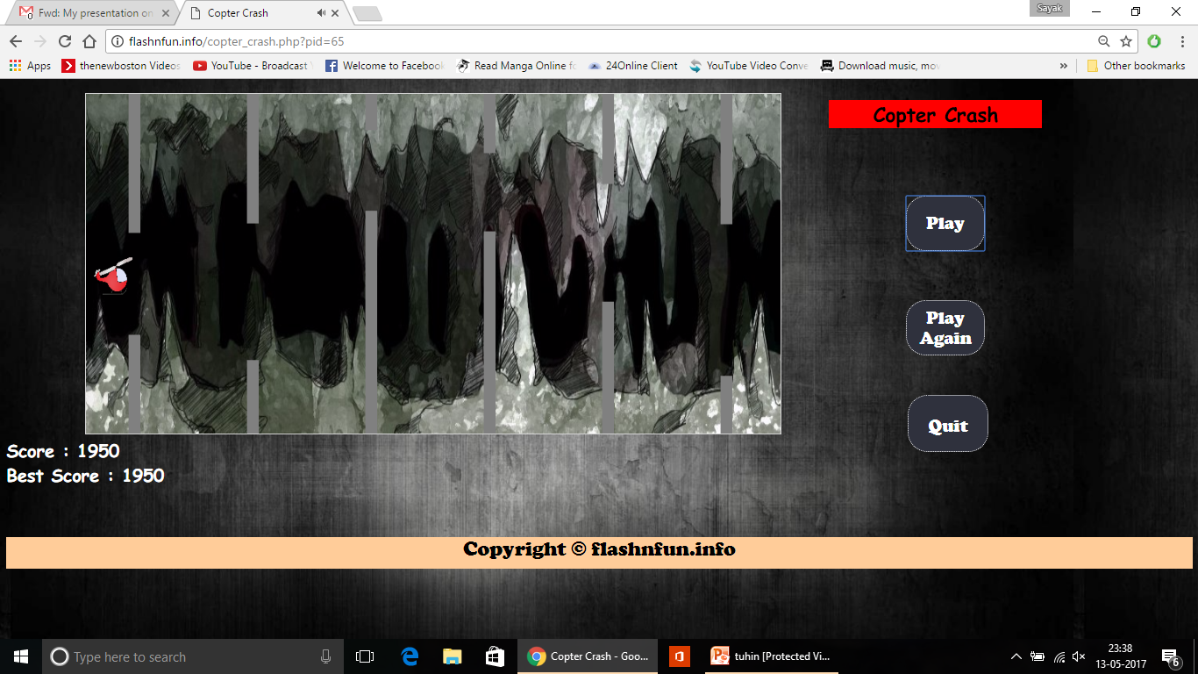
Copter Crash
Game Development Modules:
Player Car movement & collision Detection
Object Collision & randomization
Score and Best Score on heads up display
Game Control(play, play again, quit, score, best score)
Game UI & Animation(static background, random obstacle generation, player image)

Slide 17
GAME 7

Slide 18
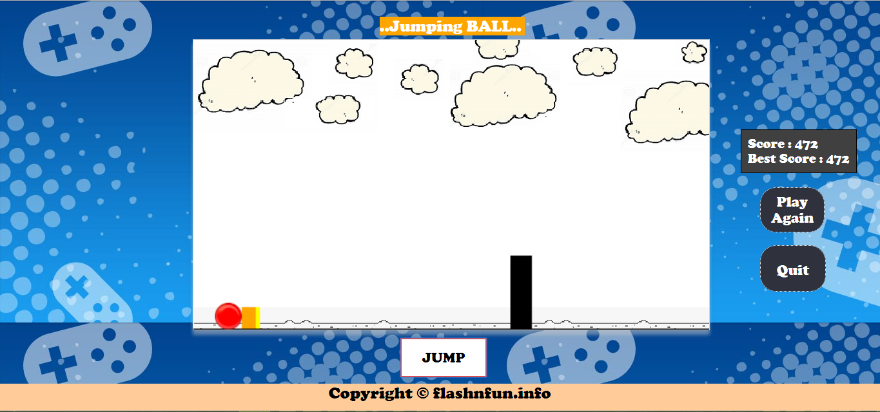
Jumping Ball
Game Development Modules:
Player ball movement & collision Detection
Object Collision & randomization
Score and Best Score on heads up display
Game Control(jump, play again, quit, score, best score)
Game UI & Animation(static background, random obstacle generation, player image)

Slide 19
GAME 8

Slide 20
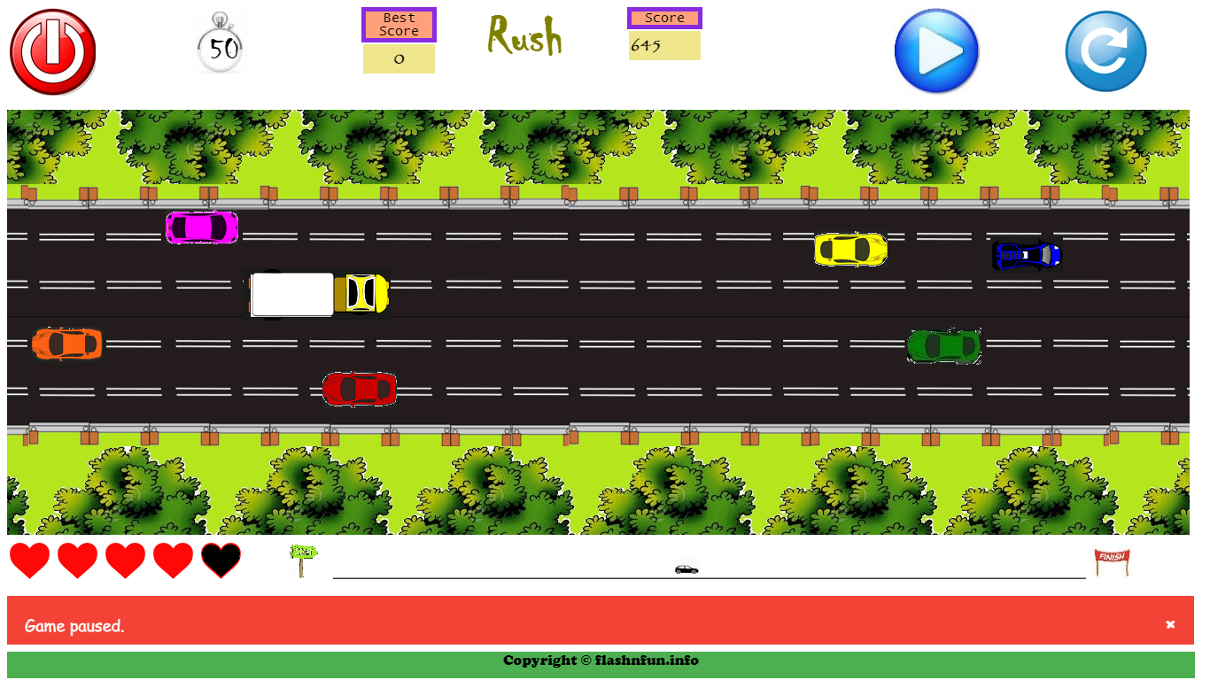
Rush
Game Development Modules:
Player Car movement & collision Detection
Traffic Collision & randomization
Timer, Life & Distance-meter
Game Control(pause/play, restart, quit, score, message-bar)
Game UI & Animation(road, scenery, traffic, player-car)

Slide 21
GAME 9

Slide 22
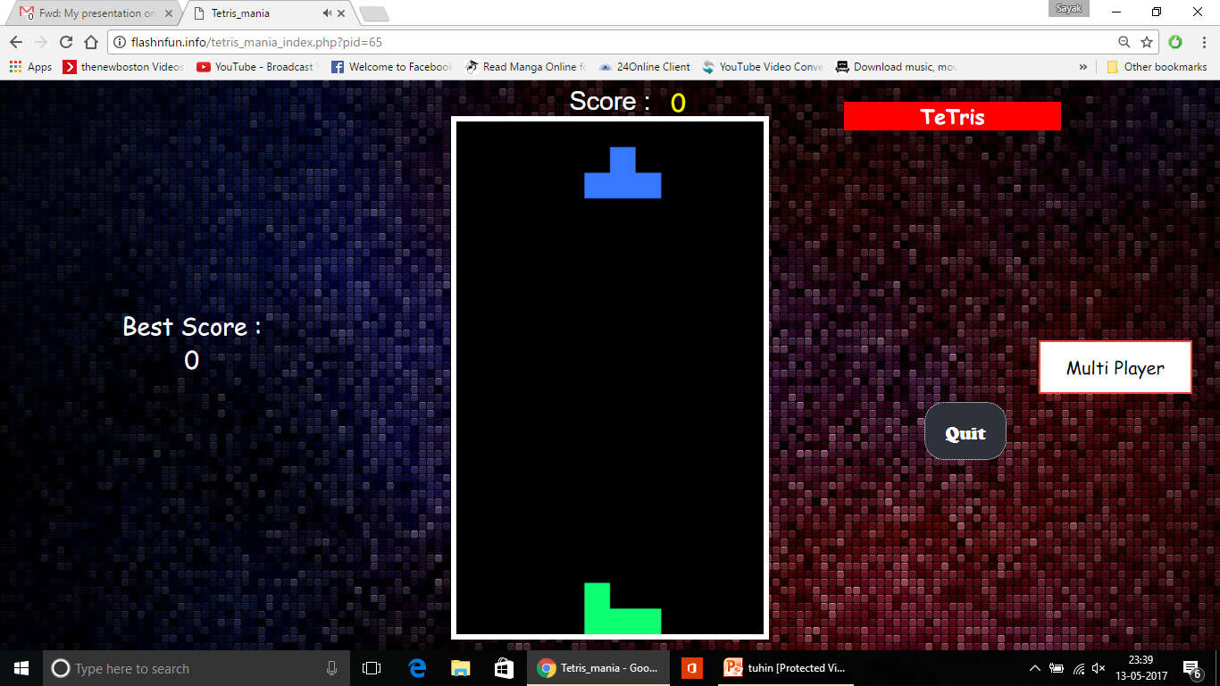
Tetris (single-player)
Game Development modules (single-player):
Game UI & Animation( randomly generated tetris blocks)
Game control( Quit, multi-player, best score, score)
Tetris blocks movement & collision detection

Slide 23
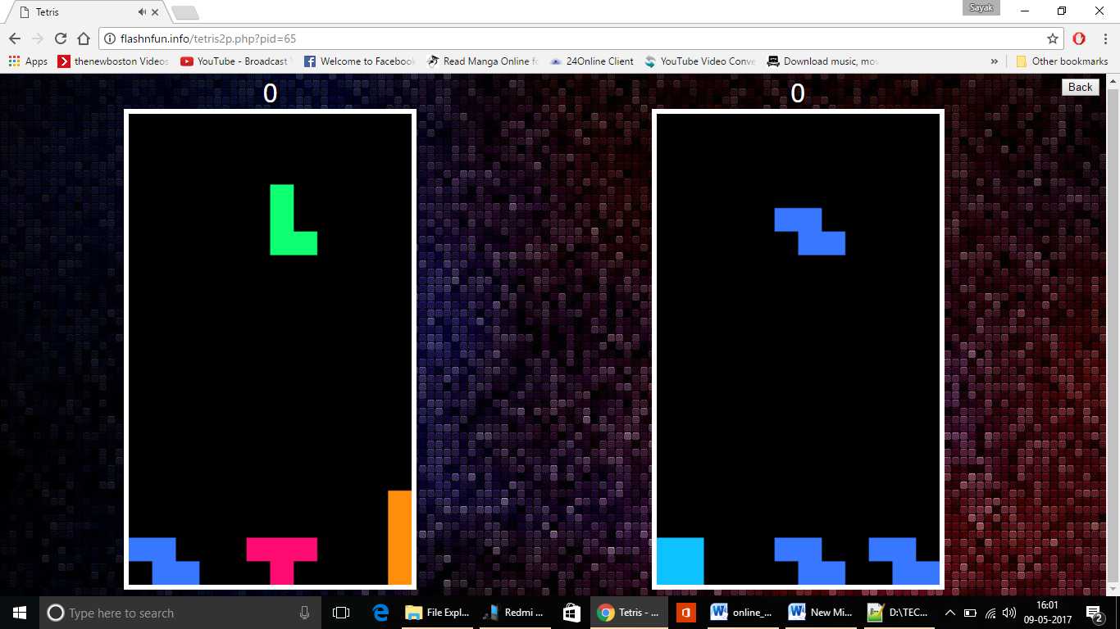
Tetris(multi-player)
Game Development modules (multi-player):
Game UI & Animation( randomly generated tetris blocks)
Game control( back button, score)
Tetris blocks movement & collision detection

Slide 24
GAME 10

Slide 25
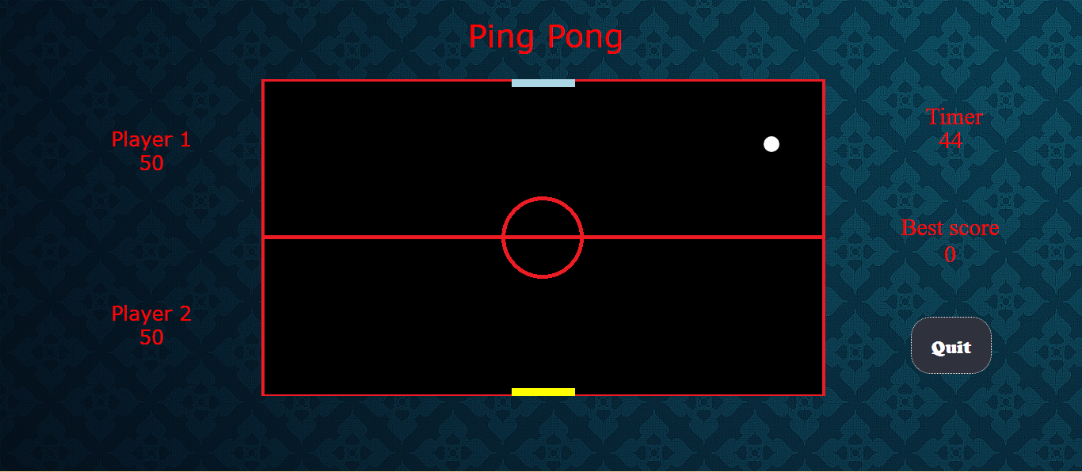
Ping-Pong
Game Development modules :
Game UI & Animation(Players and the ball initialization)
Game control( Quit, Player1 Score, Player2 Score, Timer, Best Score)
Player movements, ball update, score calculation

Slide 26
GAME 11

Slide 27
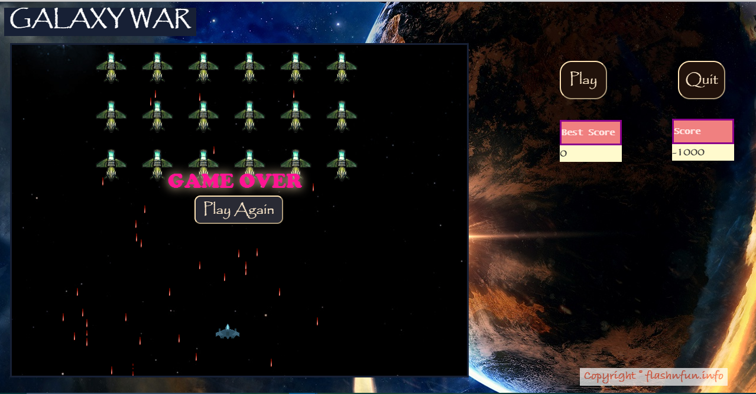
Galaxy War
Game Development Modules:
Arcade Flash Game.
The Basics (Background, Player Ship, Enemy Ship, Player Ship Bullet and Enemy Ship Bullet all are images)
Game UI (canvas with a layer of enemy ship, enemy ship bullet, player ship & player ship bullet)
Game Control (play, quit, play again, score, highest score)
Player spaceship movement along bullet launching and collision detection.

Slide 28
GAME 12

Slide 29
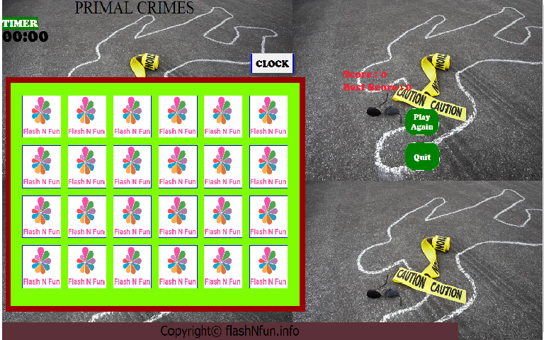
Primal Crimes
Game Development Modules:
Strategy based memory game.
Shuffling of respective tiles
Timer(Clock)
Game Control(play, Play again, quit, score)
Game UI (canvas with respective boxes having identical pairs of equipments, crime scene)

Slide 30
DATABASE DESIGN

Slide 31
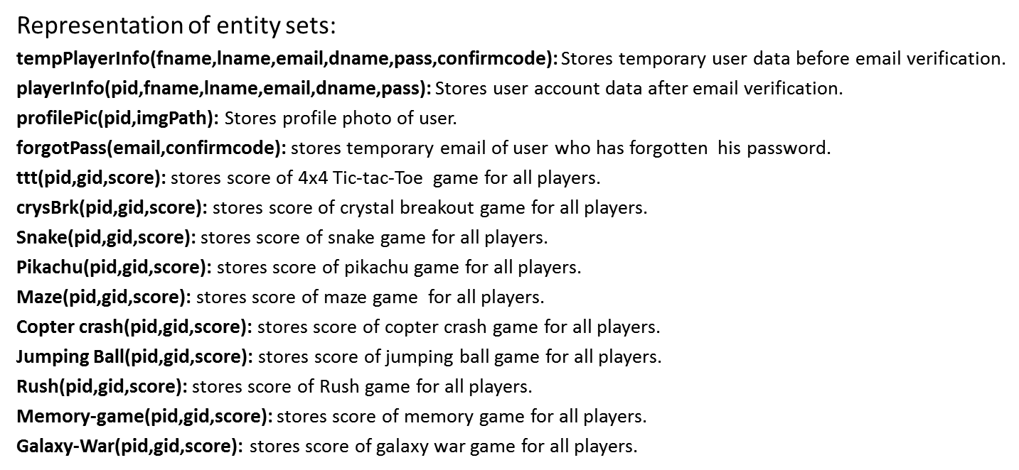
Database Schemas

Slide 32
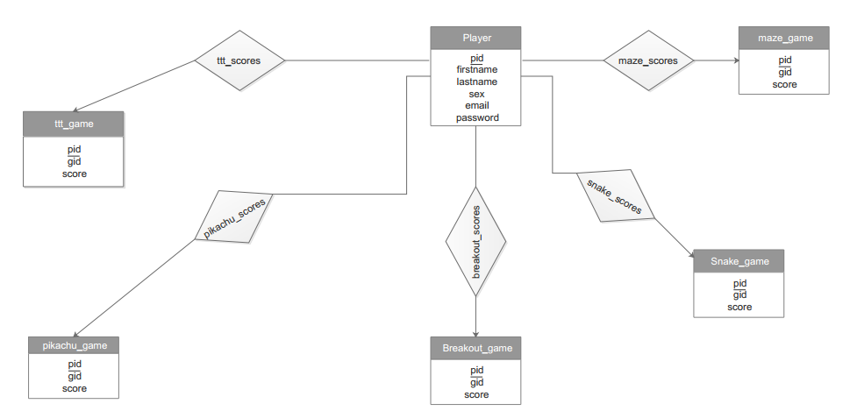
E-R Diagram

Slide 33
WEBSITE DESIGN

Slide 34
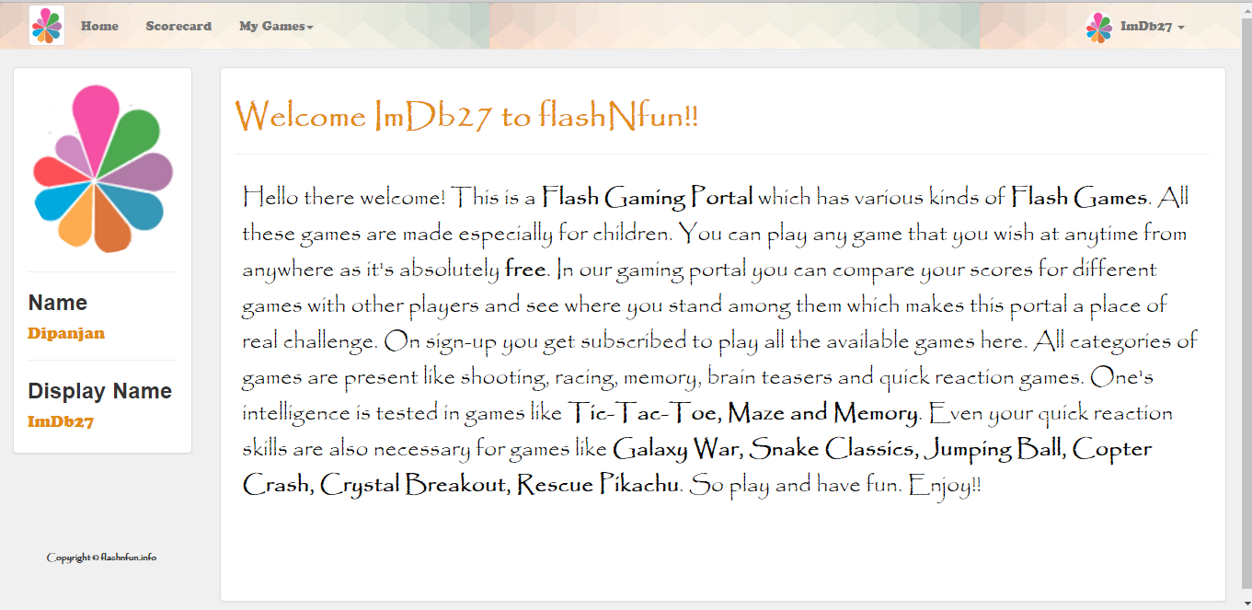
Profile page Snapshot

Slide 35
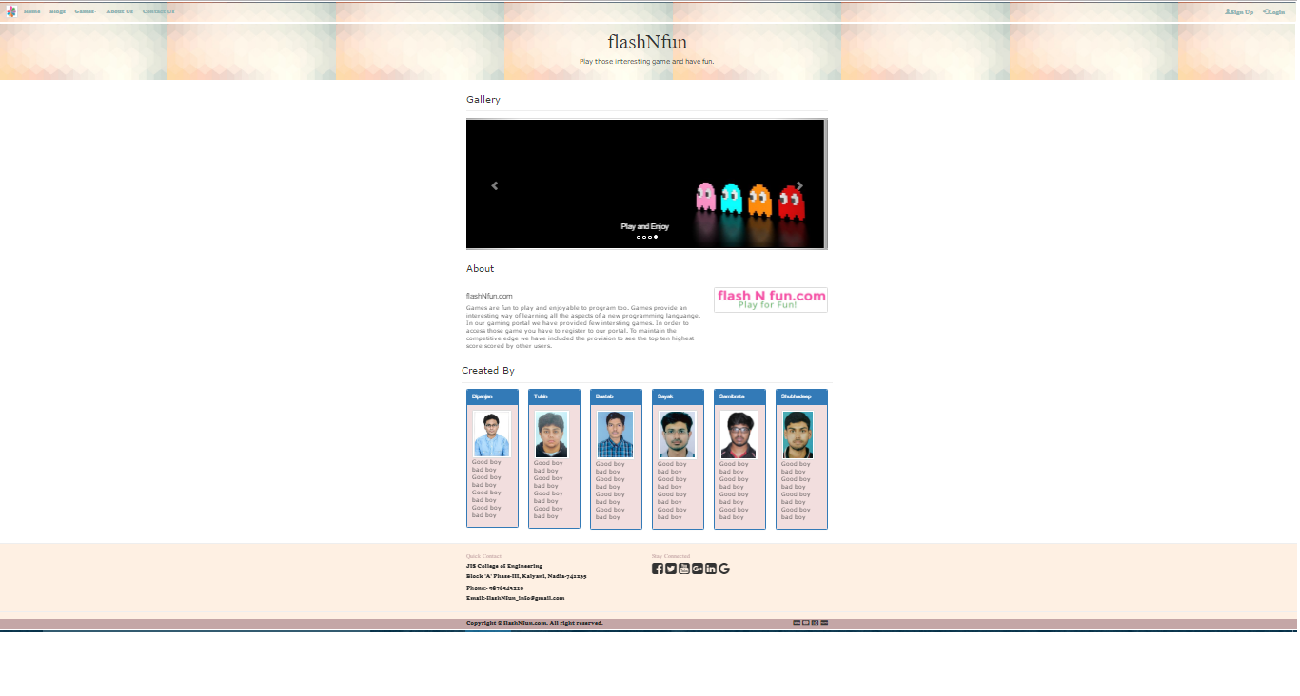
Website snapshot

Slide 36
Website Designing
Our website is designed using Bootstrap.
What we have used to design our website are
We have used Jumbotron over here.
A jumbotron indicates a big box for calling extra attention to some special content or information on the website.
We have user carousel for image slider.
The carousel plugin is a component for cycling through elements.
We have used modal for the login page.
The modal plugin is a dialog box or a popup window that display on the top the current page.

Slide 37
Website Features
Email verification.
Forgot password.
Profile picture upload.
Scoreboard showing the users who have scored the highest scores of each of the games.
Editing profile details.

Slide 38
CONCLUSION
A lot of people spend hours over the internet playing games. Games are an excellent source of entertainment for the young and old alike. For children and teen it acts as an excellent way of time pass and for the mature population it acts as a very good way of removing stress. Keeping that in mind we would definitely love to keep updating our website in the future. Due to the shortage of time provided for this project we could develop only twelve games to give a demonstration for our idea. But it’s a non-ending process. We will be keep adding new games as new ideas come to our minds to keep our users glued to the portal. Till then we hope you have good time playing the already present games!

Slide 39
Any Questions ?

Slide 40


